Slide 1

Reconfigurable Intelligent Surface for Green Edge Inference in Machine Learning
Sheng Hua, Yuanming Shi
ShanghaiTech University
Notes:
Good afternoon, everyone, today I will give you a talk about reconfigurable intelligent surface for green edge inference in machine learning.

Slide 2
Outline
Motivations
Storage, latency, power
Two vignettes:
Energy-efficient edge cooperative inference
Why inference at network edge?
Edge inference via wireless cooperative transmission
Reconfigurable intelligent surface empowered edge inference
Why reconfigurable intelligent surface?
Joint phase shifts and beamforming vectors design
Notes:
This is the outline of this talk. We will first discuss several motivations for edge machine learning, afterwards we will talk about the edge cooperative inference systems, where our main focus is the energy consumption; finally we will talk about reconfigurable intelligent surface empowered edge inference systems. I will explain these concepts in details.

Slide 3
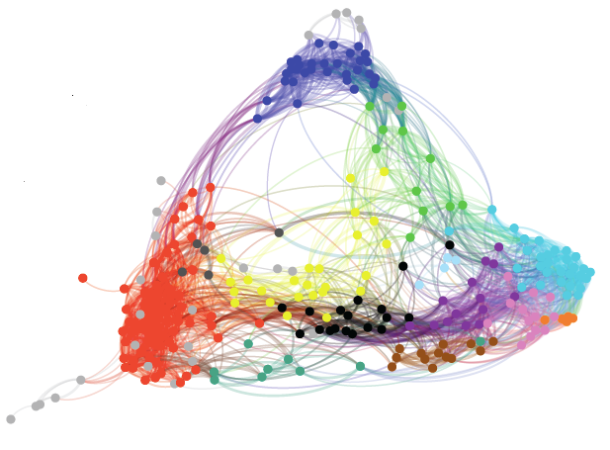
Vignettes A: Energy-efficient edge cooperative inference

Slide 4
Why edge inference?
Notes:
Why we consider edge inference?

Slide 5
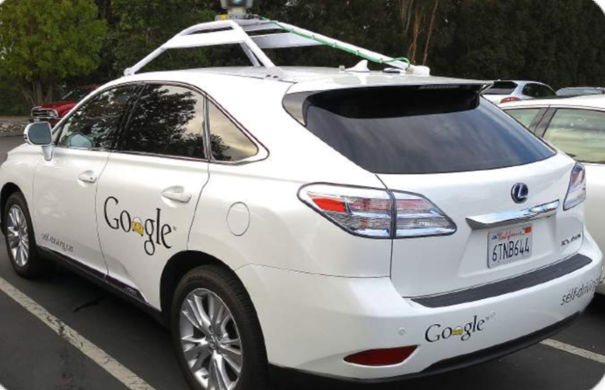



AI is changing our lives
self-driving car
smart robots
machine translation
AlphaGo
Notes:
Nowadays artificial intelligence is changing our lives in a variety of intelligent applications, e.g., self-driving cars, smart robots and so on. The great success of AI in recent years benefits from the availability of big data, increasing computing power, and of course, the more and more complicated deep neural network models.

Slide 6
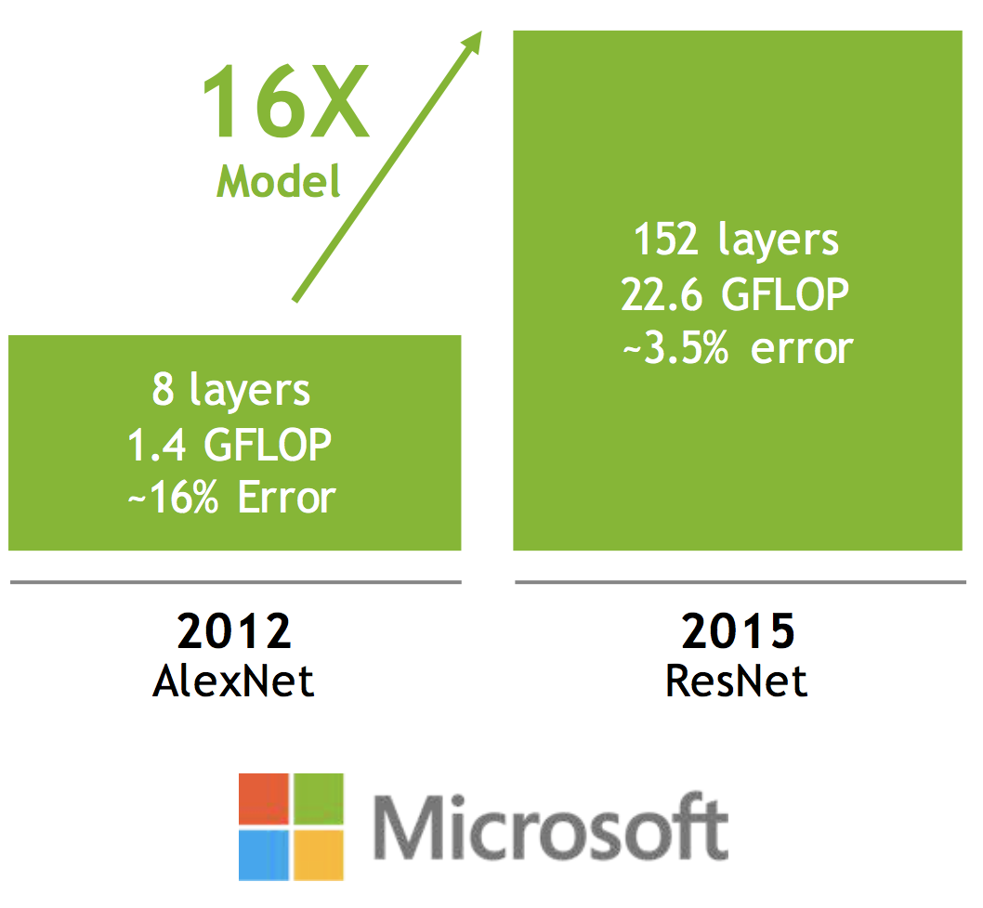
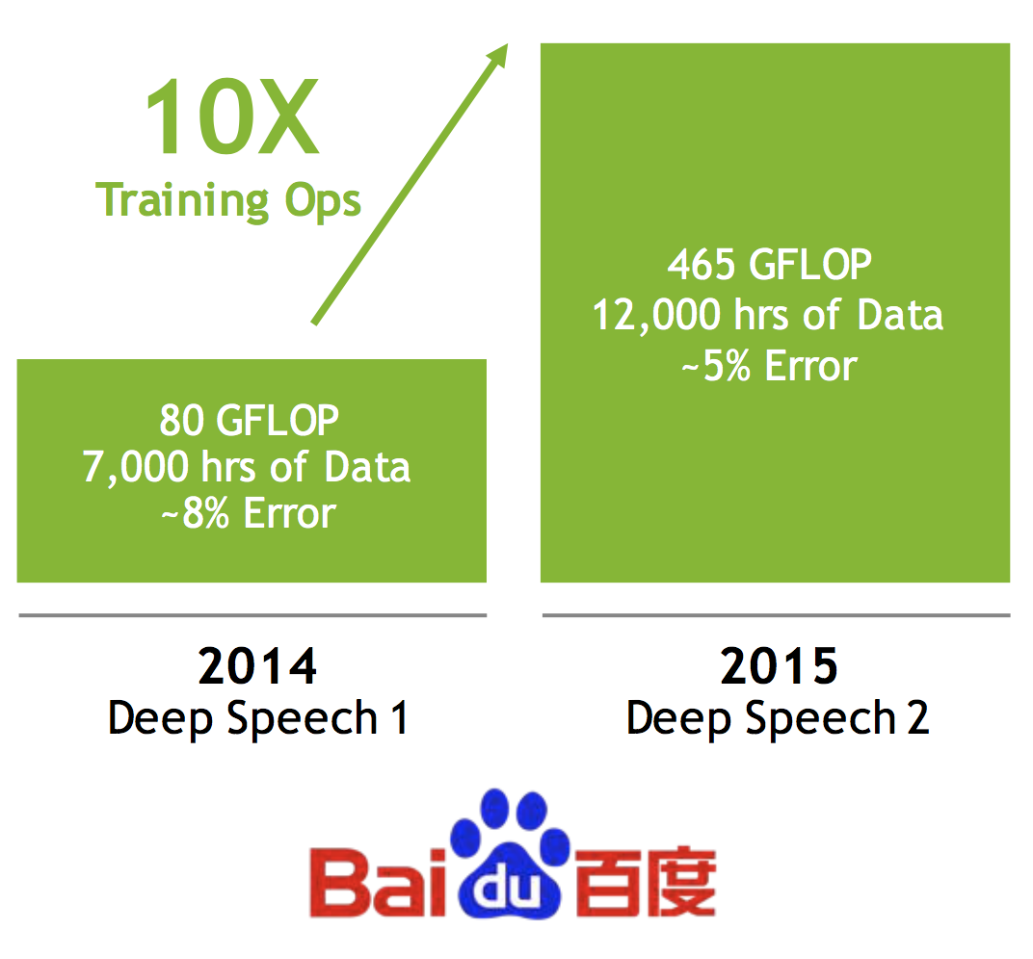
Models are getting larger
image recognition
speech recognition
Fig. credit: Dally
Notes:
As we can see from the left figure, there is a sharp increase in model parameters to make them more precise. These large volume of parameters make the model hard to converge, therefore a much longer training time is required, as shown in the right figure. Typically, the mainstream of neural network models and applications are kept in the servers of Internet companies and run in a cloud-centric manner. But nowadays, our mobile devices are generating a large volume of data to be processed (for example, we take many photos every day). What about providing intelligent services for mobile devices?

Slide 7
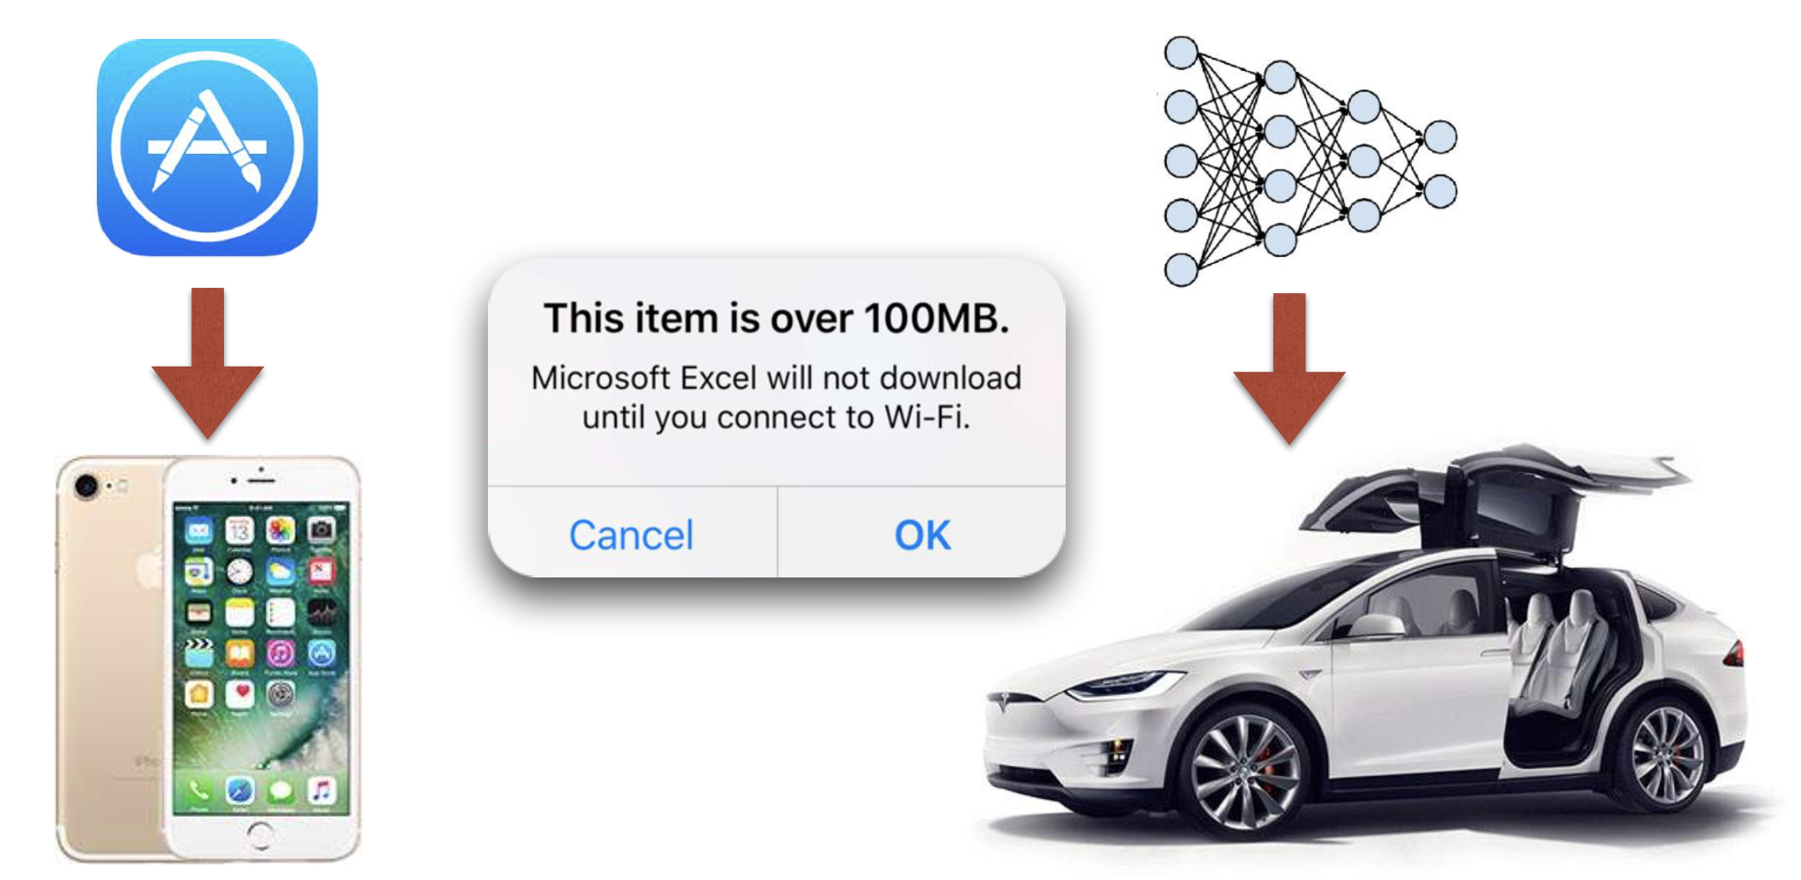
The first challenge: model size
Fig. credit: Han
difficult to distribute large models through over-the-air update
Notes:
One possible way is to deploy neural network models on devices, and directly run them on device. Unfortunately, this is not easy. The first challenge is the model size, today’s mobile devices are still limited in resources to fully deploy and run neural network models.

Slide 8




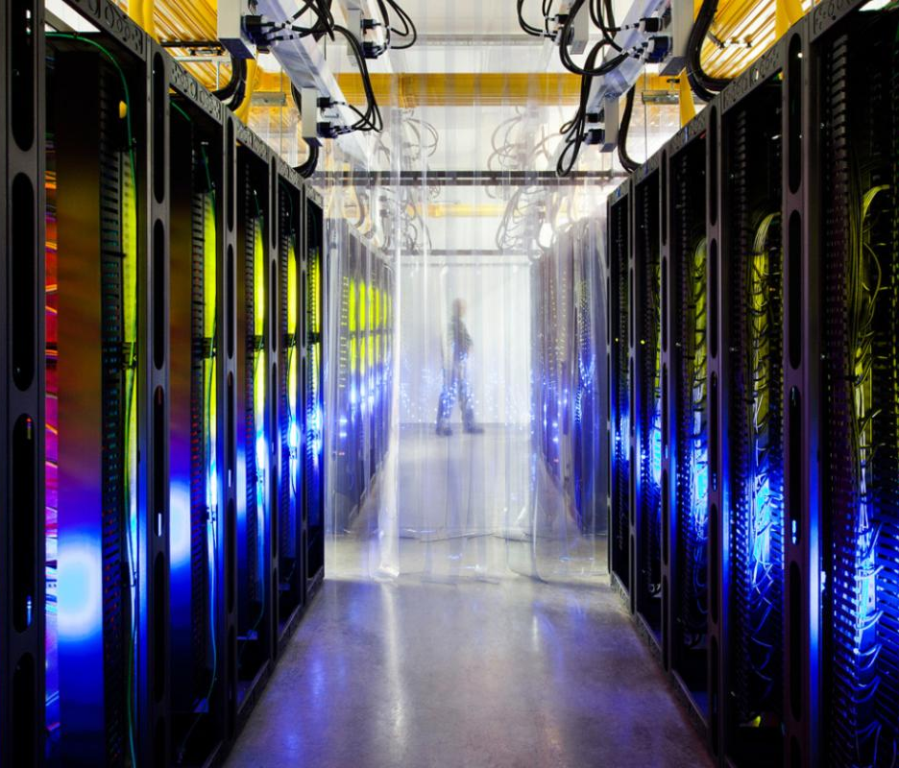
The second challenge: energy
AlphaGo: 1920 CPUs and 280 GPUs,
$3000 electric bill per game
on mobile: drains battery
larger model-more memory reference-more energy
Notes:
Even if the computation and storage capabilities of mobile devices no longer be a constraint, another concern is about the energy consumption. Because running neural network models involves in extensive computation, which will drain the battery of mobile devices very quickly.

Slide 9
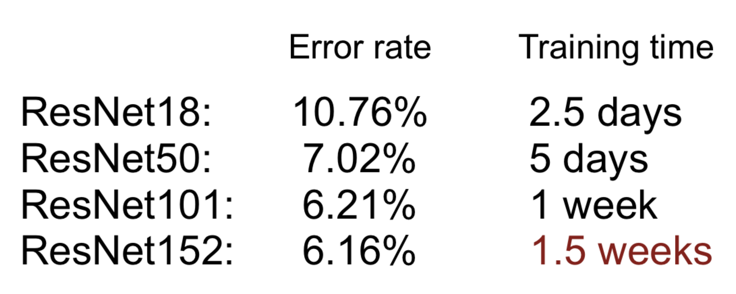


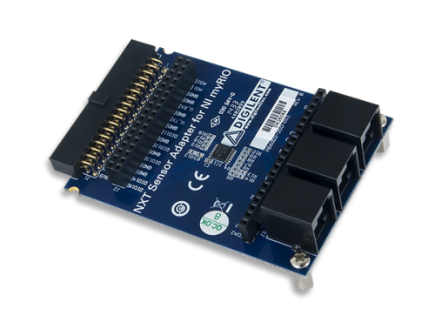


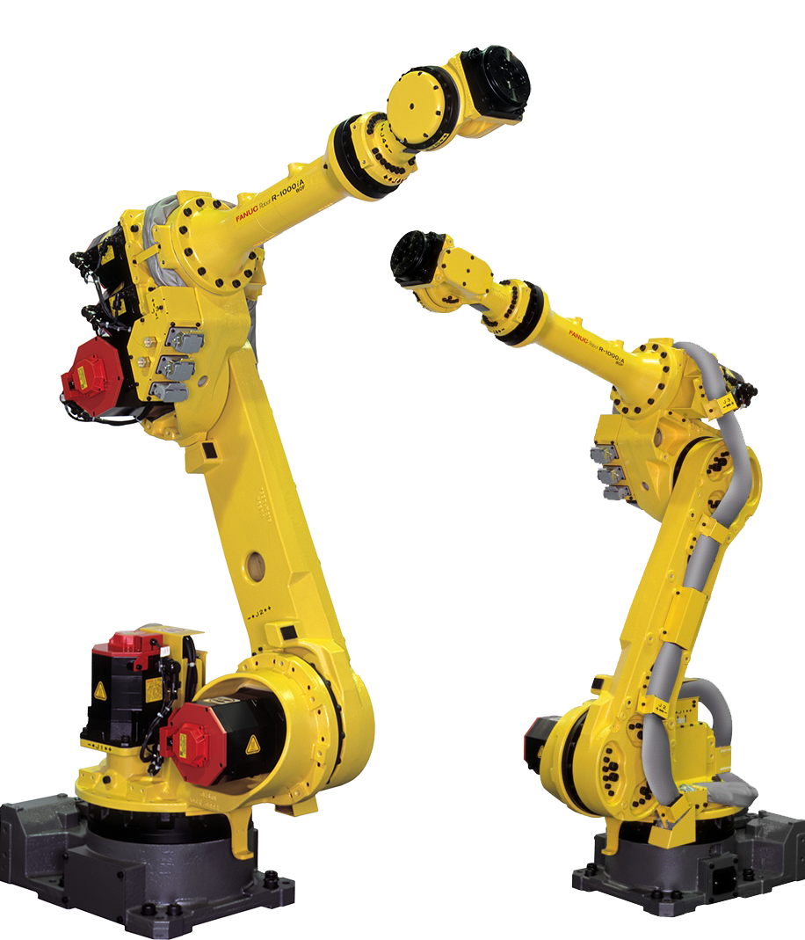
The third challenge: speed
communication
sensor
long training time limits ML researcher’s productivity
transmitter
接收器
receiver
cloud
latency
actuator
processing at “Edge” instead of the “Cloud”
Notes:
So directly run neural network models on mobile devices seems to be hopeless. We may resort to the cloud datacenters, that is, we transport the data
from the devices to the cloud datacenters for analysis, and the devices receive the execution results as the computation process finishes.
However if this is the case, the uplink data traffic will be huge, resulting in prohibitive communication overhead. In addition, several other practical issues such as privacy leakage and single-point failures should also be taken into careful consideration.

Slide 10

How to make deep learning more energy-efficient?
low power
Notes:
So what can we do? Can we make deep learning more energy-efficient to tailor for mobile devices, while still maintaining a reasonable service latency?

Slide 11
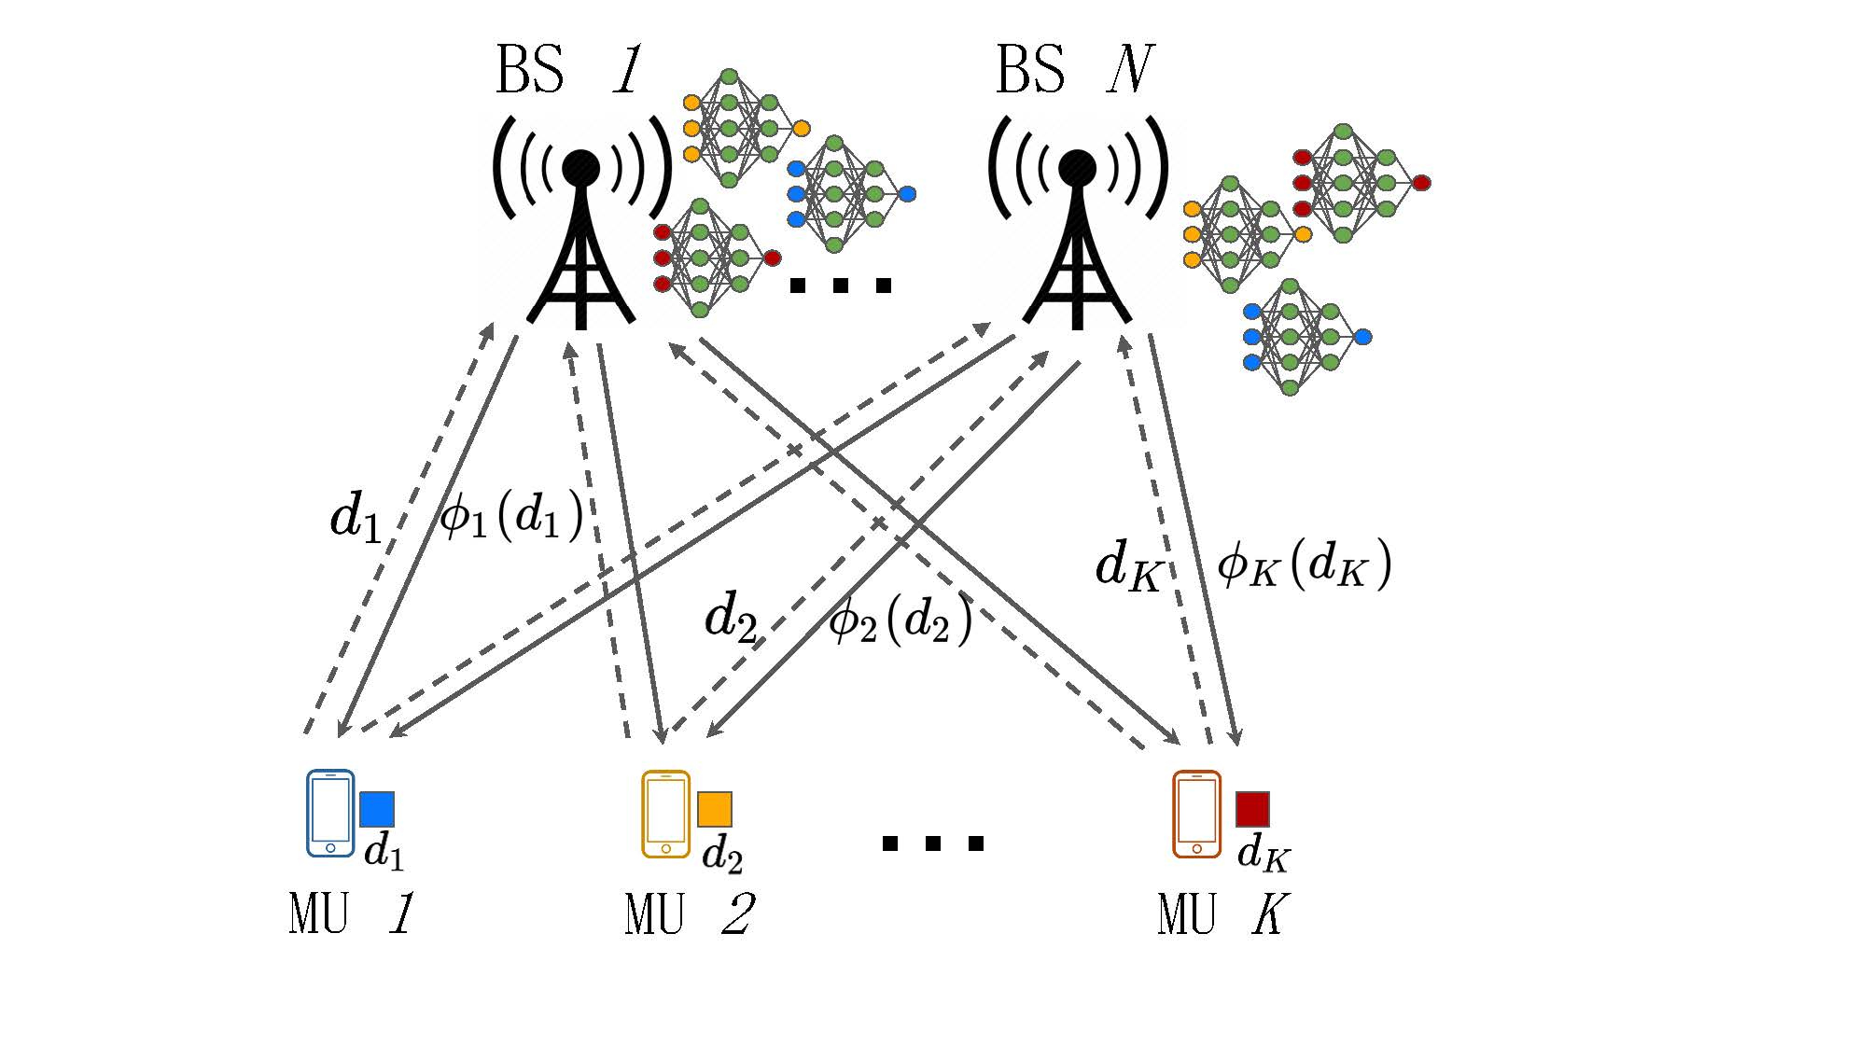



Edge inference for deep neural networks
Goal: energy-efficient edge processing framework to perform deep learning inference tasks at the edge computing nodes
any task can be performed at multiple BSs
uplink
models
downlink
models
pre-downloaded
which BSs shall compute for me?
output
input
example:
Nvidia’s GauGAN
Notes:
The answer is yes. I should make some clarifications. In this talk we will focus on the inference phase, that is, we assume the training phase are already done, and well-trained neural network models are available. The question on how to train complicated neural networks through cooperation among mobile devices is left as our future work.
We propose to leverage the benefits of mobile edge computing, by uploading the tasks generated at mobile devices to edge base stations and executing these tasks at the base stations. We assume these base stations are resource-enhanced and they have downloaded several neural network models from the cloud so that they can provide services to the devices. Note that these bases stations are near to mobile devices, so that they can provide services within a reasonable latency. The proposed edge inference system reaches a compromise between cloud-centric inference and on-device inference. Moreover, to guarantee the quality-of-service provided for devices, we explore the idea of computation replication. It means that inference tasks are allowed to be performed by multiple base stations to create multiple copies of the inference results. For each task we will select a subset of all base stations to execute.

Slide 12
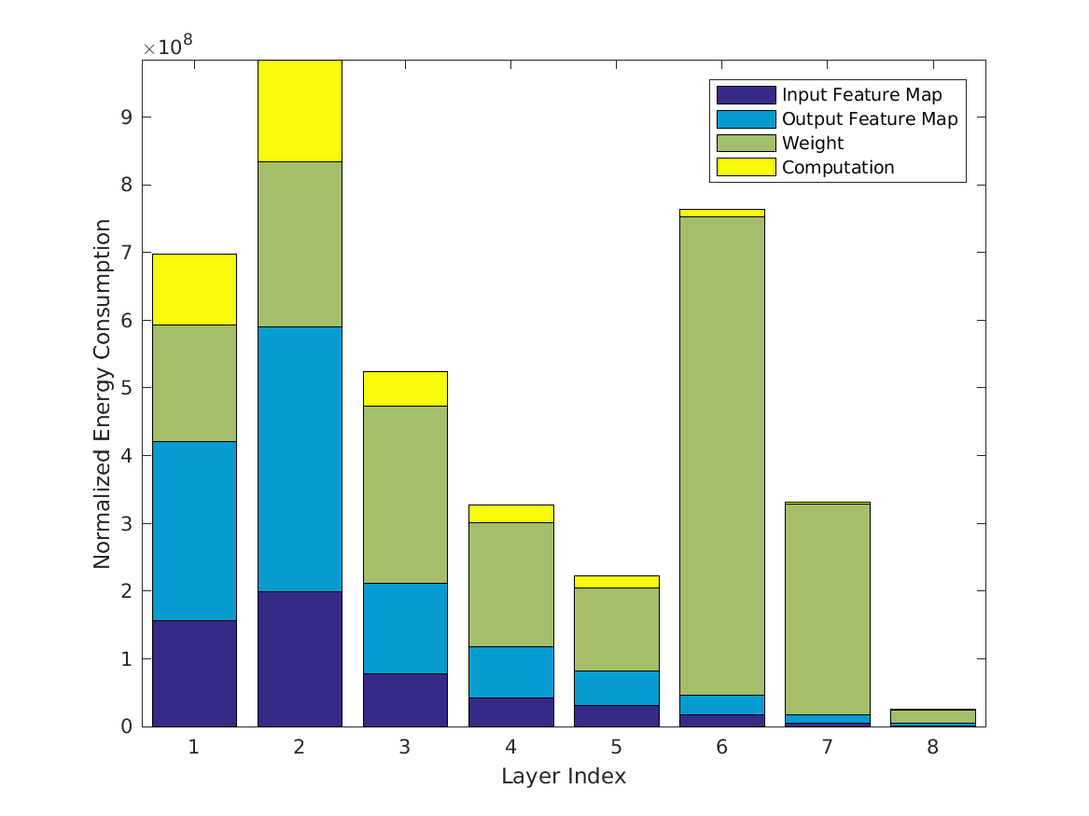
Computation power consumption
Goal: estimate the power consumption for deep model inference
Example: power consumption estimation for AlexNet
Cooperative inference tasks at multiple BSs:
Computation replication: high computation power
Cooperative transmission: low transmission power
Solution:
minimize the sum of computation and transmission power consumption
[Sze’ CVPR 17]
Notes:
We mainly focus on the power consumption in the proposed edge inference system, which consists of both computation power consumption for executing inference tasks and communication power consumption for delivering inference results. The computation power consumption can be estimated by following the methodology proposed in a previous work, which gives an arbitrary neural network a layer-wise energy breakdown. The attached figure here shows a layer-wise energy breakdown of AlexNet, which is a renowned neural network for image recognition.
Note that in our system, there exists a fundamental tradeoff in terms of power consumption. Because of computation replication, the same task are performed at multiple base stations for several times, so the computation power is large. Imagine the extreme case is each task will be executed by all base stations. However, the multiple copies of the inference results at different base stations also enable cooperative transmission, which can reduce the transmit power consumption by exploiting a higher cooperative beamforming gain. Therefore, we should strike a balance between the communication and computation power consumption, by minimizing the sum of these two parts.

Slide 13
Vignettes B: Reconfigurable intelligent surface empowered edge inference
Notes:
Recently, several works showed that an emerging technology named reconfigurable intelligent surface has the potential to significantly reduce the power consumption and improve the energy efficiency. So in this work, we consider a reconfigurable intelligent surface empowered edge inference system.

Slide 14
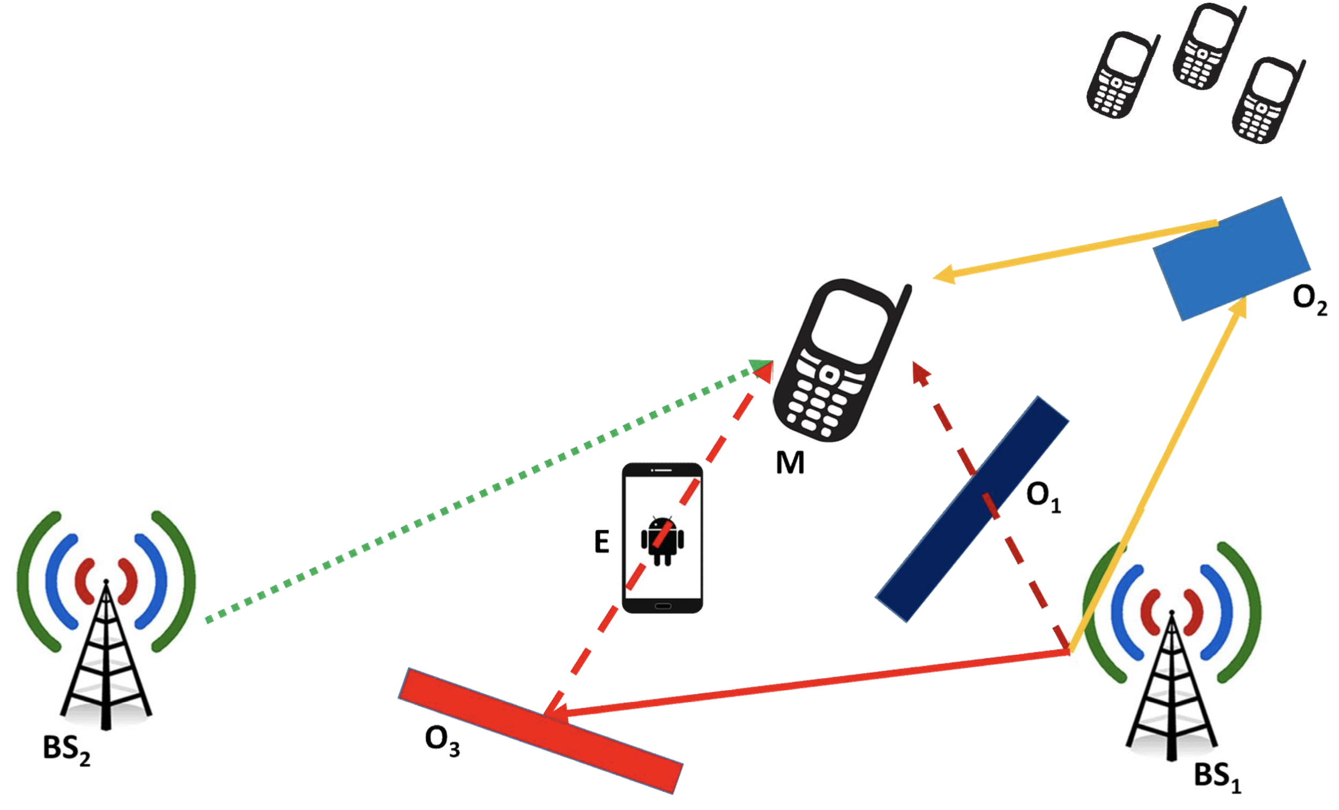
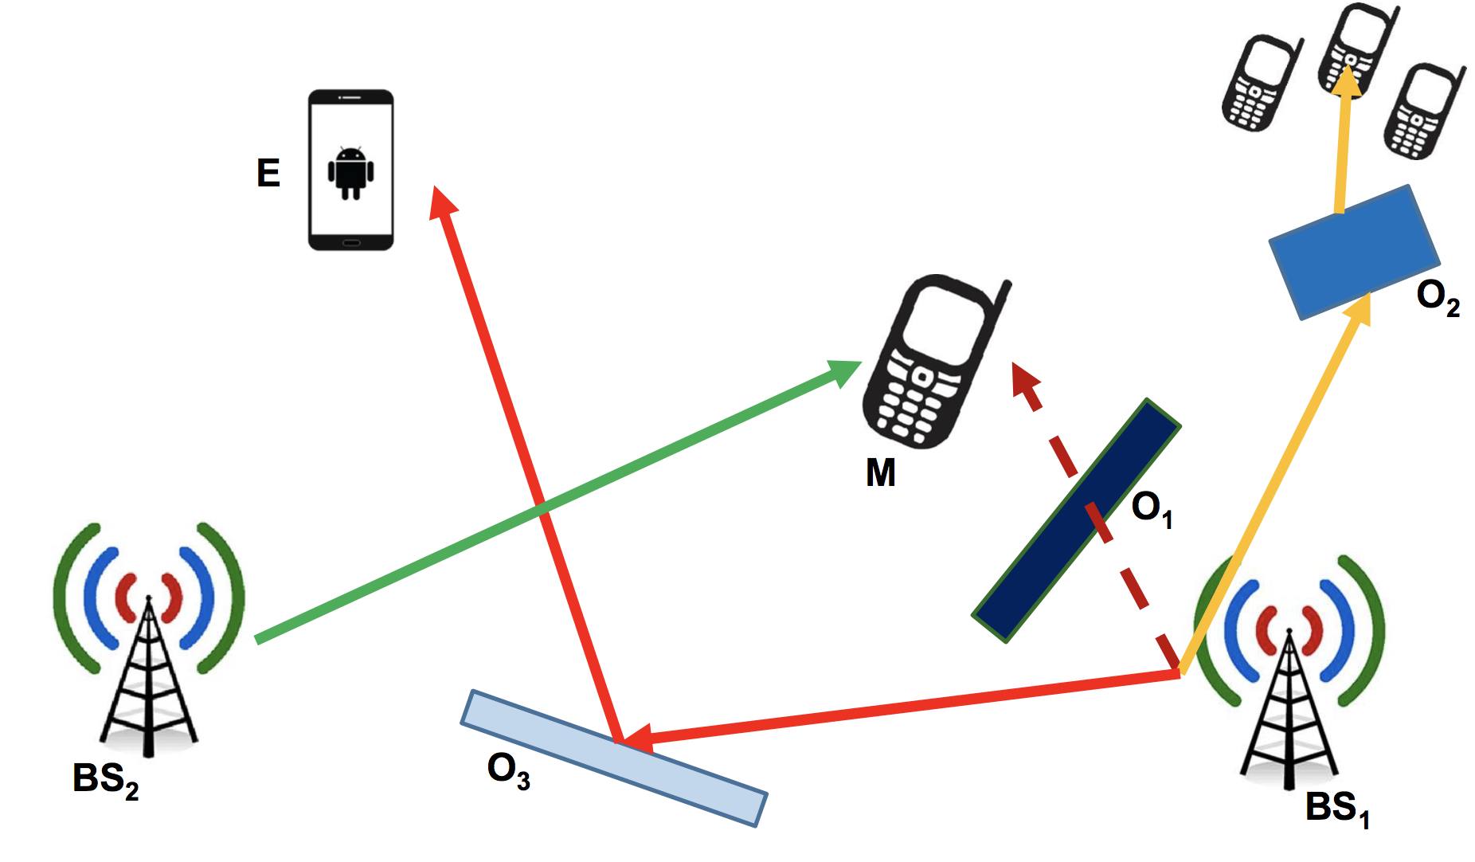

Smart radio environments
Current wireless networks: no control of radio waves
Perceive the environment as an “unintentional adversary” to communication
Optimize only the end-points of the communication network
No control of the environment, which is viewed as a passive spectator
Smart radio environments: reconfigure the wireless propagations
“dumb” wireless
“smart” wireless
Fig. credit: Renzo
Notes:
Reconfigurable intelligent surface improve the performance of wireless communication systems by creating smart radio environments. In conventional wireless networks, we have no control of radio waves, we perceive the environment as an “unintentional adversary” to communication, and we focus on optimizing the end-points of the communication network, e.g., transceiver designs. Reconfigurable intelligent surface introduces a new degree of freedom for our design, we can in fact reconfigure the wireless propagations.

Slide 15
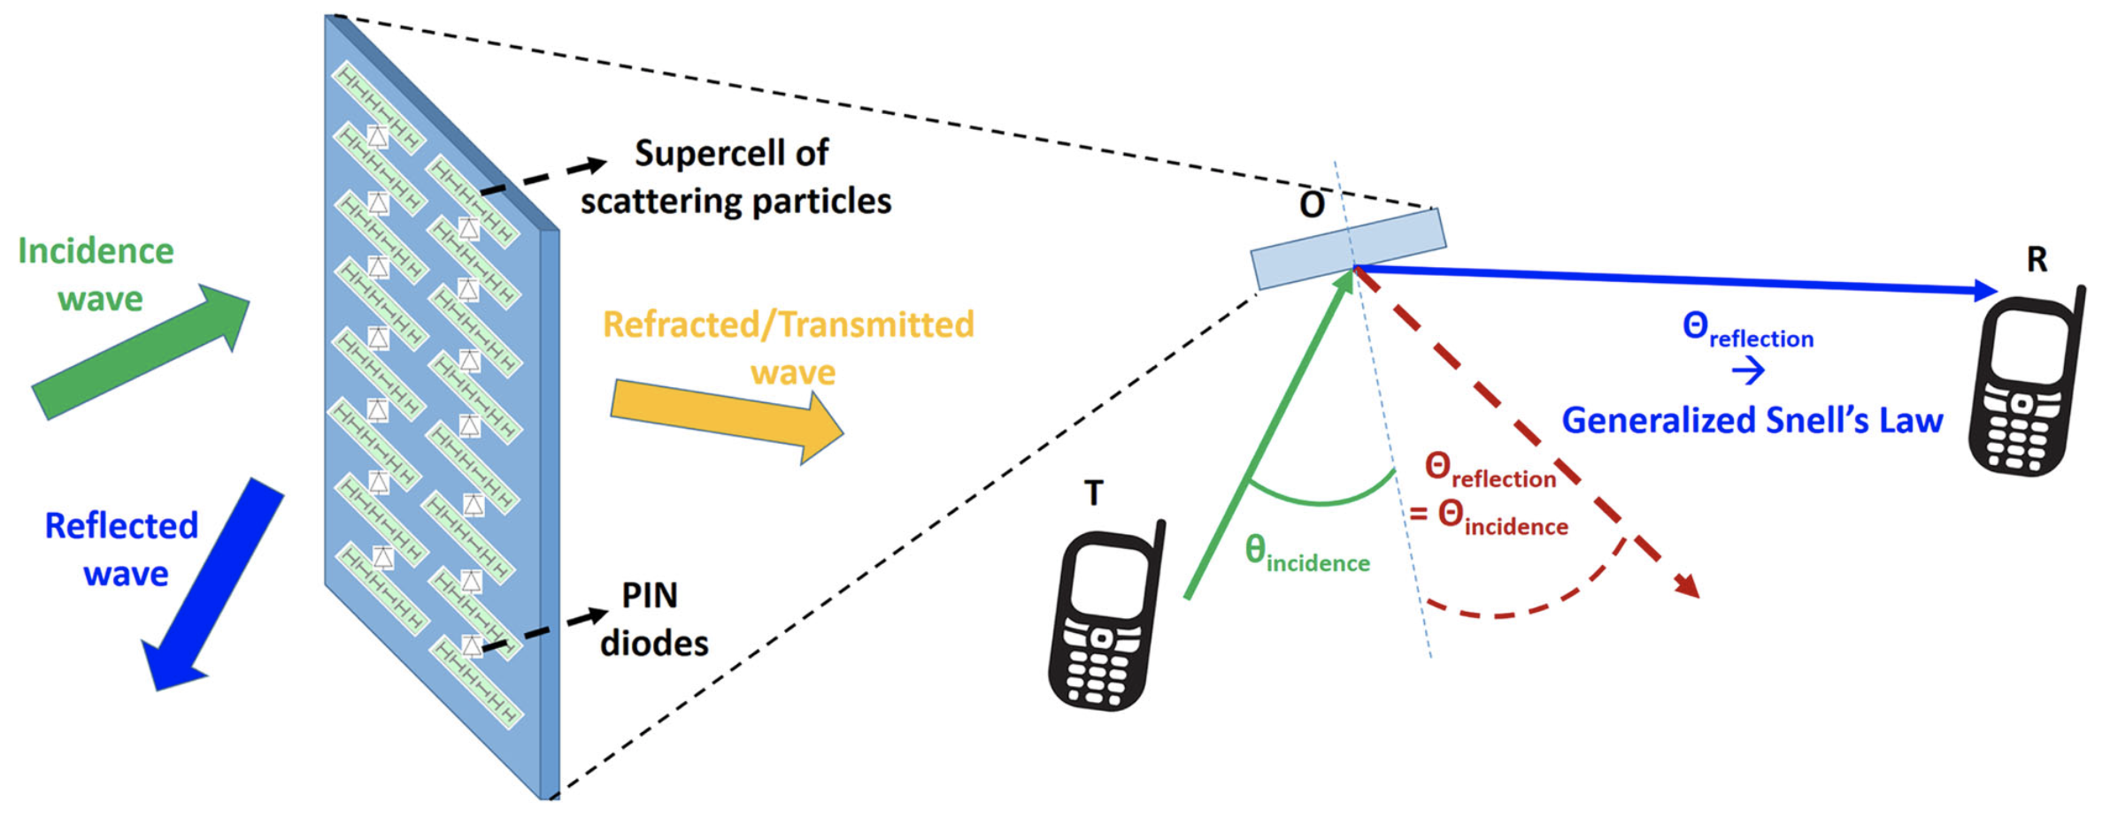
Reconfigurable intelligent surface
Working principle of reconfigurable intelligent surface (RIS): different elements of an RIS can reflect the incident signal by controlling its amplitude and/or phase for directional signal enhancement or nulling
no any active transmit module
operate in full-duplex mode
Fig. credit: Renzo
improve spectral and energy efficiency
Notes:
In principle, reconfigurable intelligent surface is a low-cost planar array consisting of a large number of passive reflecting elements with reconfigurable phase shifts and amplitudes. We can control its amplitude and phase shift to reflect the incident signal for directional signal enhancement or nulling, thereby improving spectral and energy efficiency. The figure here shows a vivid case. By tuning the phase shifts of the intelligent surface, the incident wave from the device T (green dash line) can be reflected to the device R (blue dash line). But in traditional wireless communication settings, this part of incident waves are usually wasted.

Slide 16
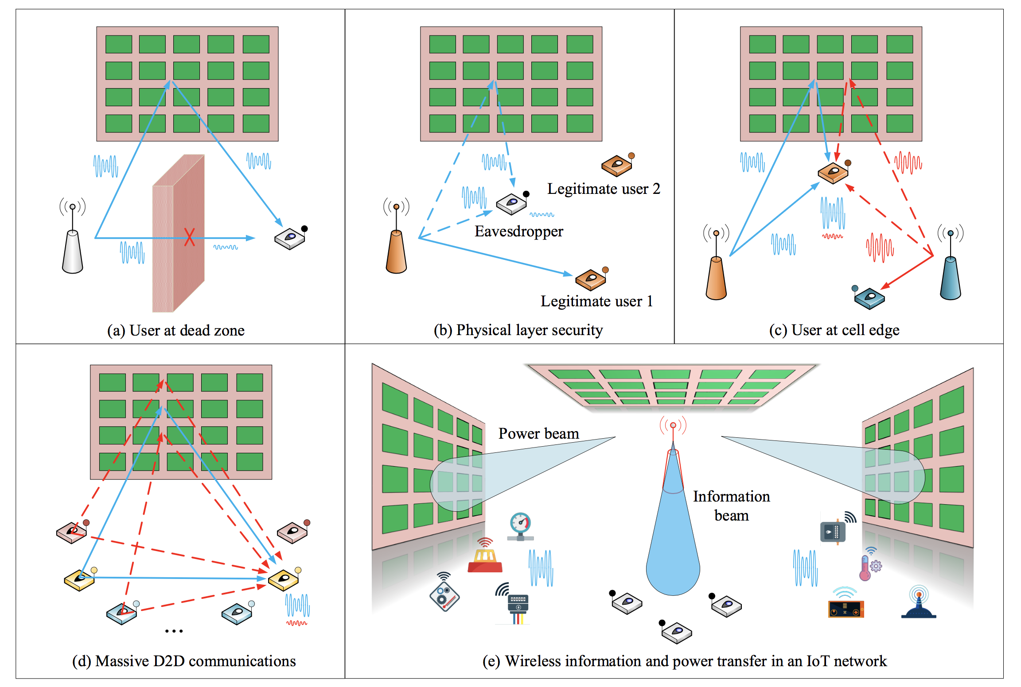
Reconfigurable intelligent surface meet wireless networks
reconfigurable intelligent surface meets wireless network:
edge inference
over-the-air computation
massive MIMO
wireless power transfer
D2D communications
NOMA
mmWave
…
Fig. credit: Wu
Notes:
Considering its benefits and huge potentials, a growing line of works have explored the possibility of reconfigurable intelligent surface empowered wireless networks, across a wide range of applications like over-the-air computation, massive MIMO, millimeter wave, and so on.

Slide 17
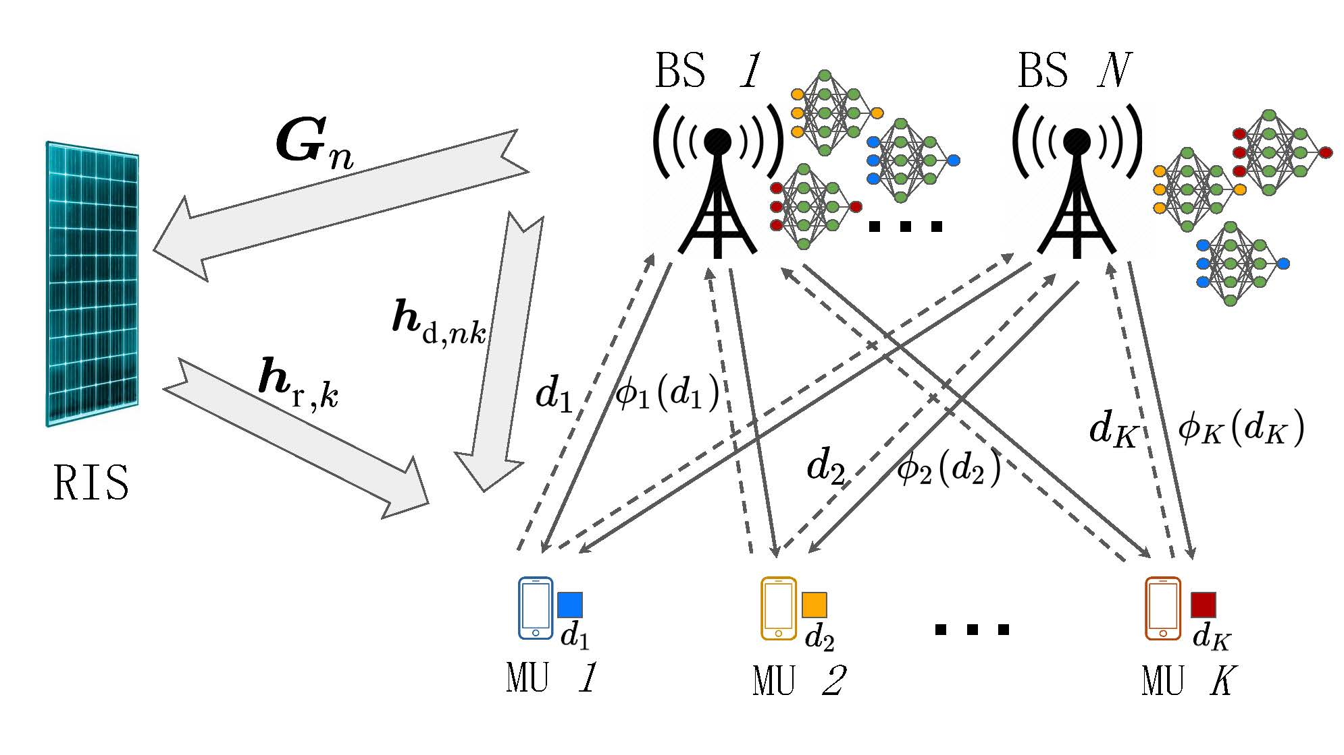



RIS empowered edge inference
Reconfigurable Intelligent surface:
overcoming unfavorable signal propagation conditions
improving energy efficiency
tuning phase shifts with passive elements
RIS aided edge inference system:
build controllable wireless environments to decrease transmit signal power
w.l.o.g. assuming
Notes:
So we consider an RIS-empowered edge inference system. This figure shows our system model. In addition to the direct channel from base stations to mobile users, the deployment of an RIS introduces a reflected channel, which is a concatenation of base station-RIS channel, phase shifts at the RIS, and the RIS-user channel. The phase shifts at the RIS is modeled as a diagonal matrix with diagonal entries denoting the amplitude and phase of individual reflecting elements. Without loss of generality, we assume the amplitude of all reflecting elements is one.

Slide 18




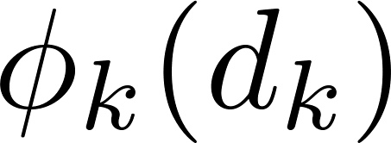



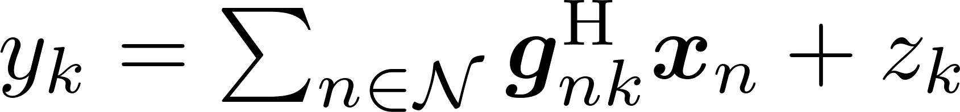
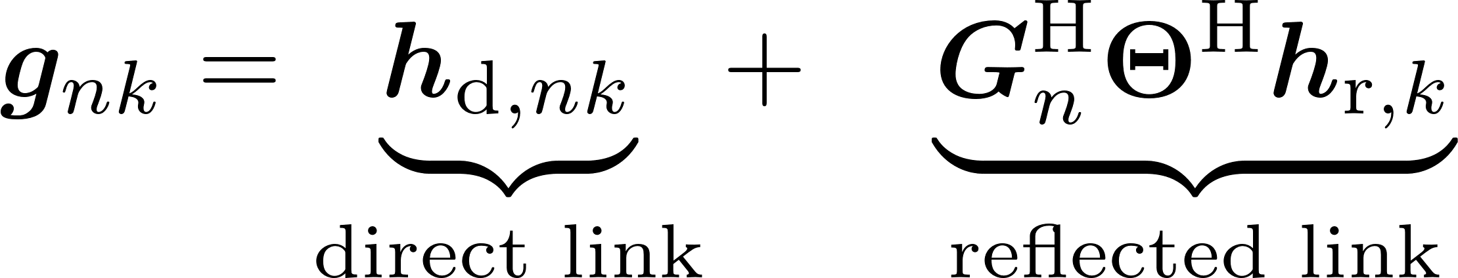
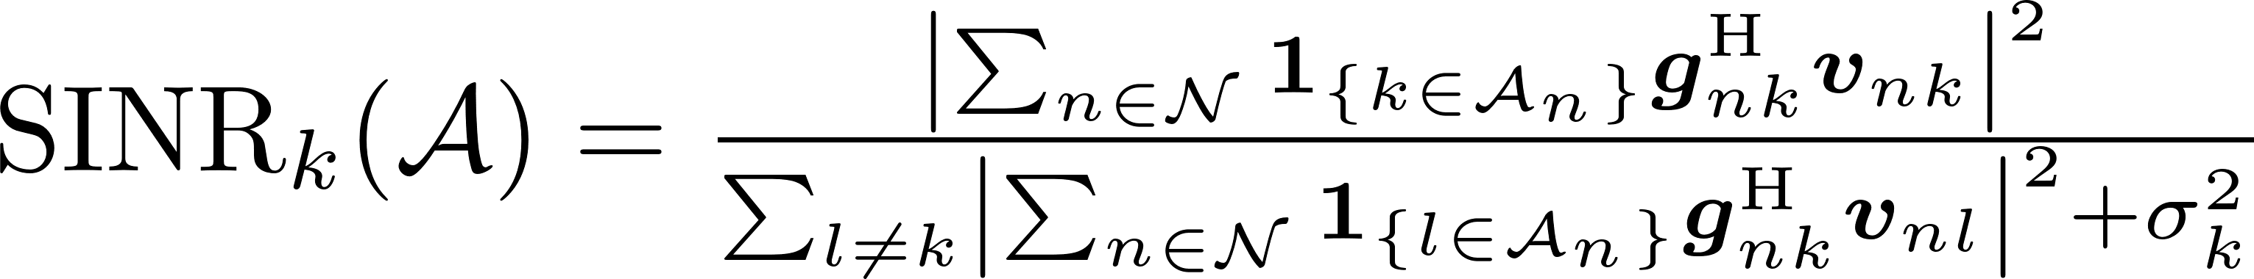
Signal model
Proposal: MU ’s task performed at multiple BSs
transmitted signal at BS :
beamforming vector for at BS :
signal received by MU :
equivalent channel response from BS to MU :
the SINR for MU :
Notes:
We denote the tasks performed at base station n as A_n, which is a subset of K. The transmitted signal at base station n is given as x_n, which is a summation of the beamformed signals for those k in A_n, here v_nk is the beamforming vector at base station n for user k’s task result. With frequency reuse, the signal received by user k is the summation of signals sent from all base stations plus additive white gaussian noise z_k. Here g_nk is the equivalent channel response from base station n to user k, which consists of the direct link and reflected link. Based on the signal model, we can write the SINR obtained for user k as the following form.

Slide 19
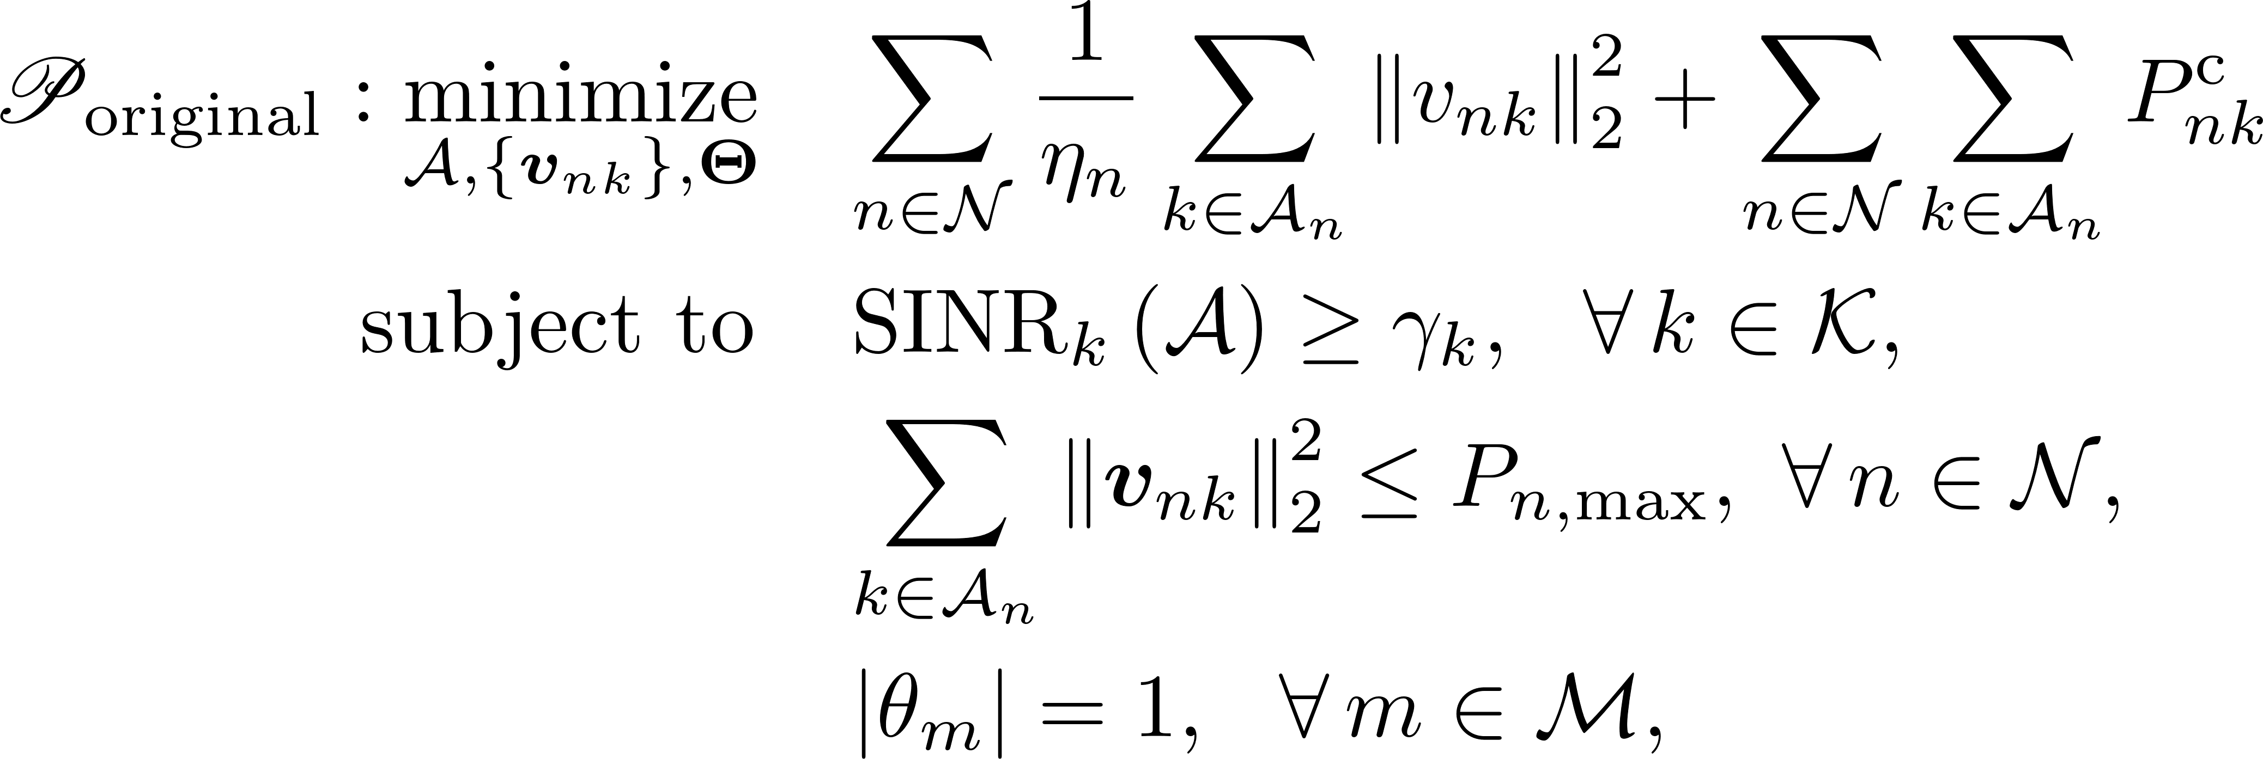

Energy-efficient edge inference
Goal: minimize total power consumption under QoS constraints
Challenges:
1. mixed combinatorial optimization problem because of combinatorial variable
2. coupled optimization variables in SINR constraints
3. nonconvex unit-modulus constraints induced by the RIS
sum of communication and computation power consumption
(maximum transmit power)
phase shifts design
Notes:
Our interested energy-efficient edge inference problem can be formulated as a total power consumption minimization problem under quality-of-service and several other practical constraints. Here the objective function is the sum of communication and computation power consumption in the system, while the constraints consist of the quality-of-service constraints, maximum transmit power constraints for each base station, and the unit modulus constraints induced by the reflecting element of the reconfigurable intelligent surface. However, the formulated problem is highly intractable. We are faced with three main challenges. The first one is the combinatorial variable A in both the objective function and quality-of-service constraints. The second challenge is that the beamforming vectors and phase shifts are coupled with each other in quality-of-service constraints. And the third challenge is that the unit-modulus constraints induced by the RIS are nonconvex.

Slide 20
Group Sparsity Inducing and An Alternating Framework
Notes:
In order to tackle these challenges and facilitate effective algorithm design, we exploit group sparsity inducing norm and propose an alternating framework.

Slide 21

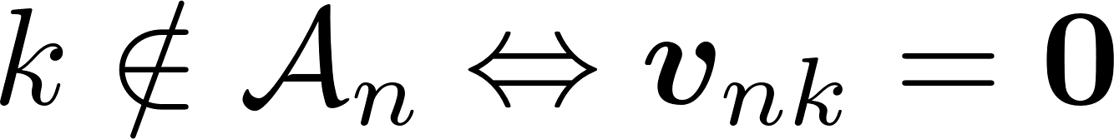
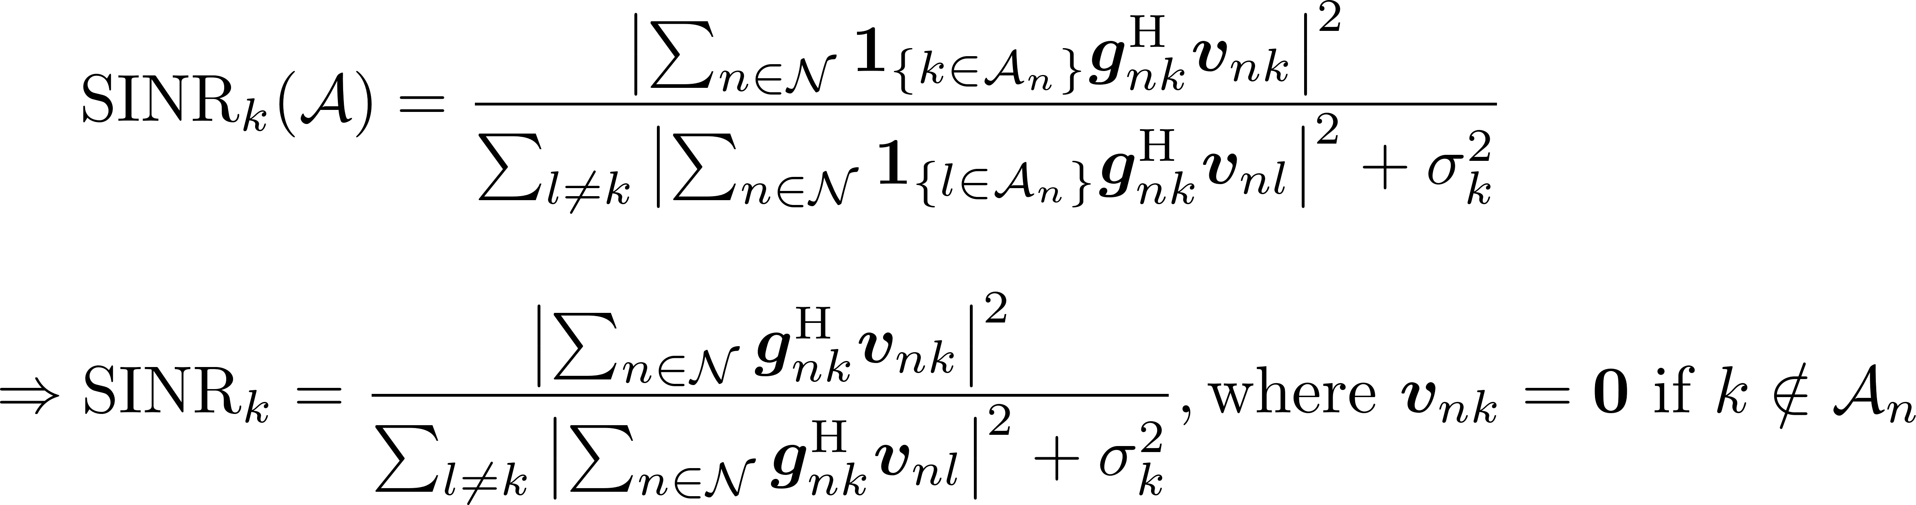
Group sparse beamforming for power minimization
Proposal: group sparse beamforming approach to get rid of the combinatorial variable
Key observation:
Notes:
Group sparsity structure of the beamforming vectors are exploited to address the challenge of combinatorial variable. This is based on the key observation that k not in A_n is equivalent to the beamforming vector v_nk equals to zero. This is because, if k is not in A_n, meaning that base station n will not perform the task from user k, and then deliver results to user k. Based on this observation, we can get rid of the combinatorial variable A, and equivalently rewrite the objective function and quality-of-service constraints into the corresponding forms.

Slide 22
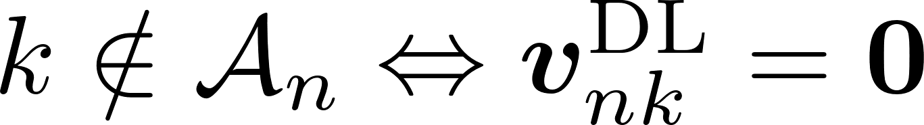
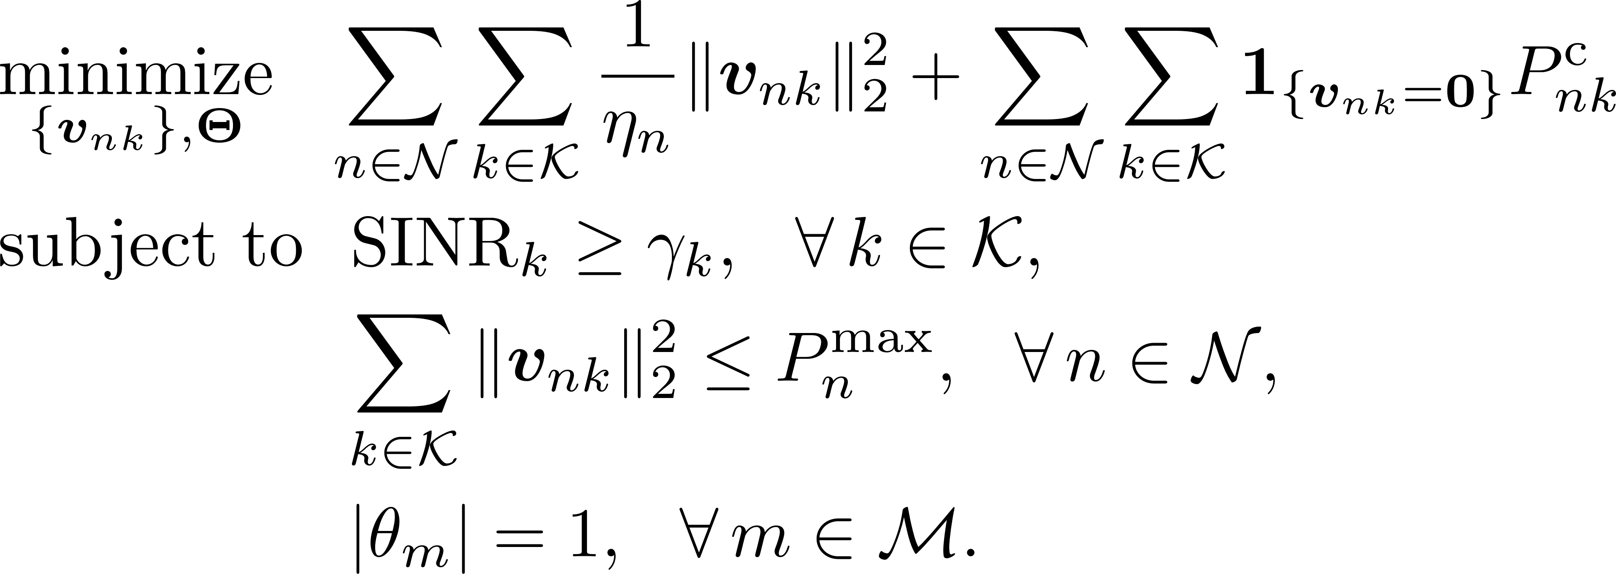
Group sparse beamforming for power minimization
Proposal: exploit group sparsity structure beamforming to get rid of the combinatorial variable
Notes:
And the original problem is then recast as this problem.

Slide 23


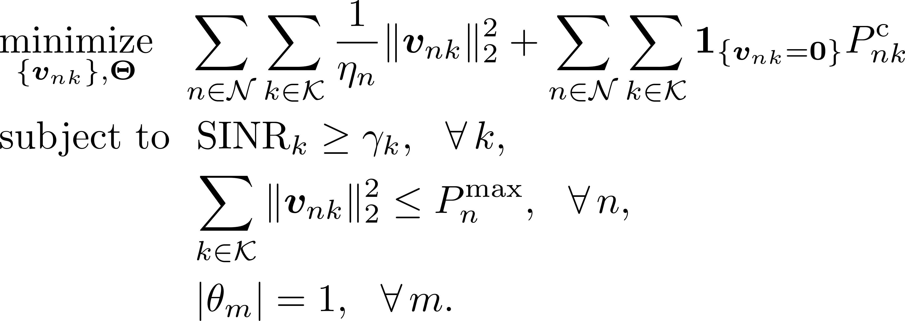
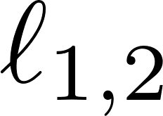
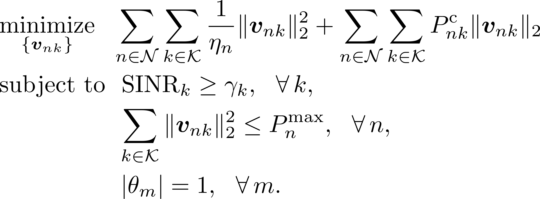
An alternating framework
Stage I: updating beamforming vector with fixed RIS phase shifts
mixed -norm for
group sparsity inducing
Notes:
In order to address the second challenge of coupled optimization variables, we adopt an alternating approach to alternatively optimize beamforming vectors and phase shifts. Specifically, with fixed phase shifts Theta, we aim to induce the group sparsity of beamforming vectors. Mixed \ell_{1,2}-norm is then adopted to induce group sparsity.

Slide 24

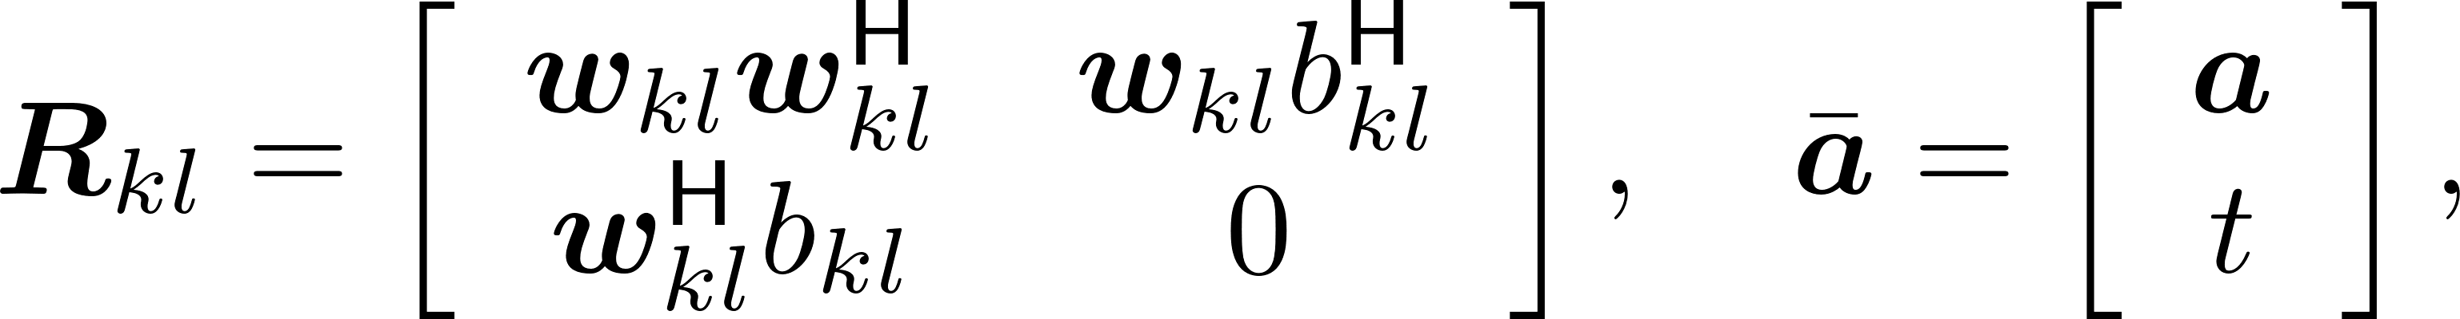
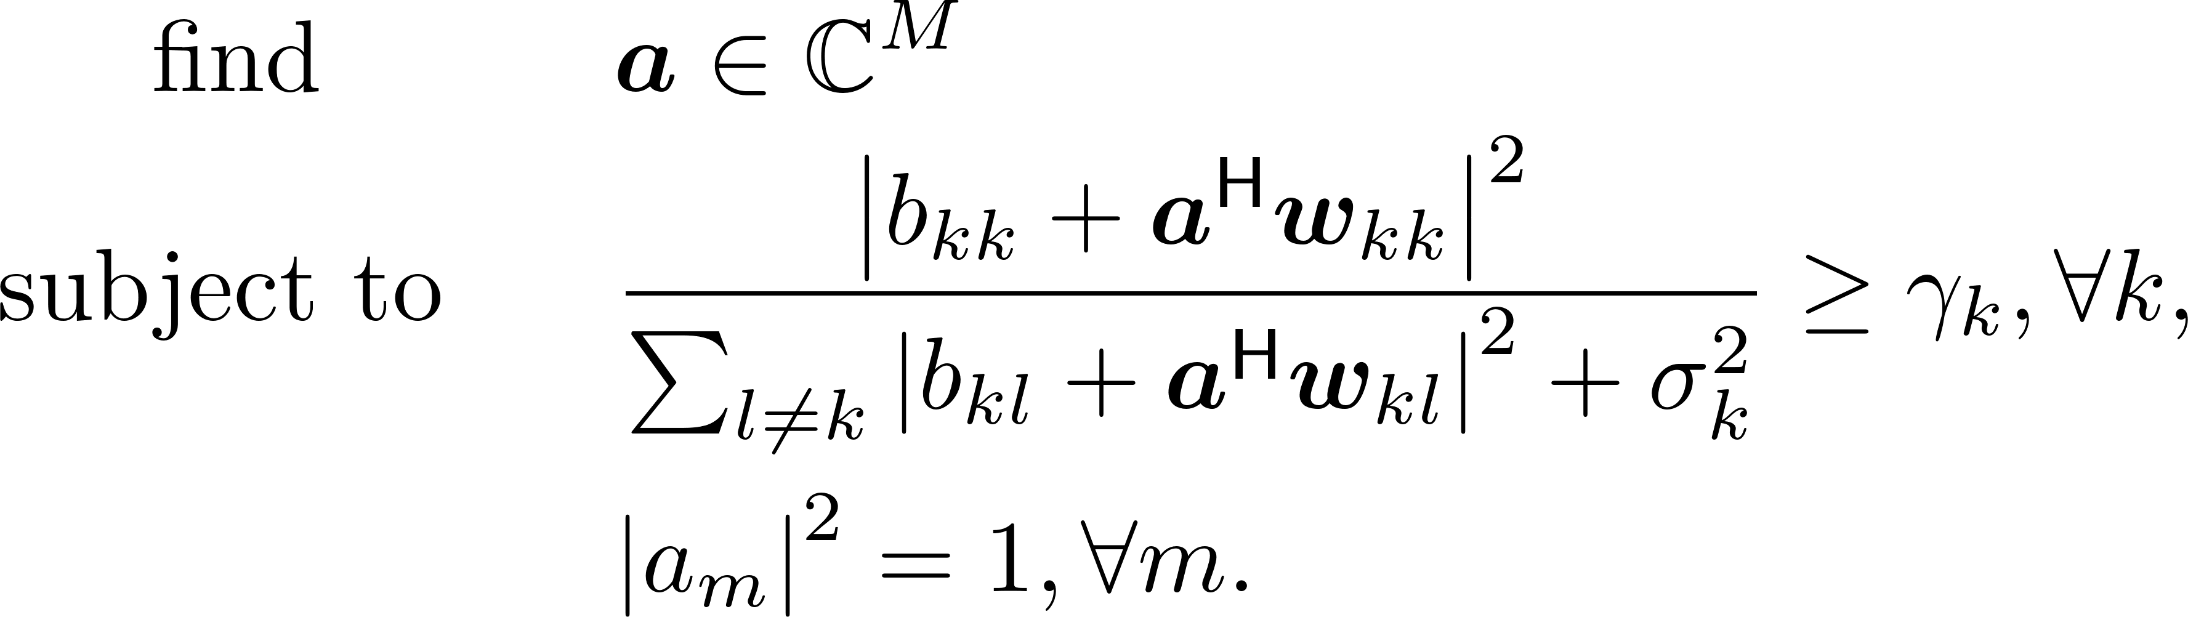
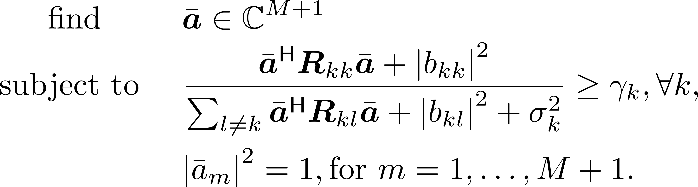

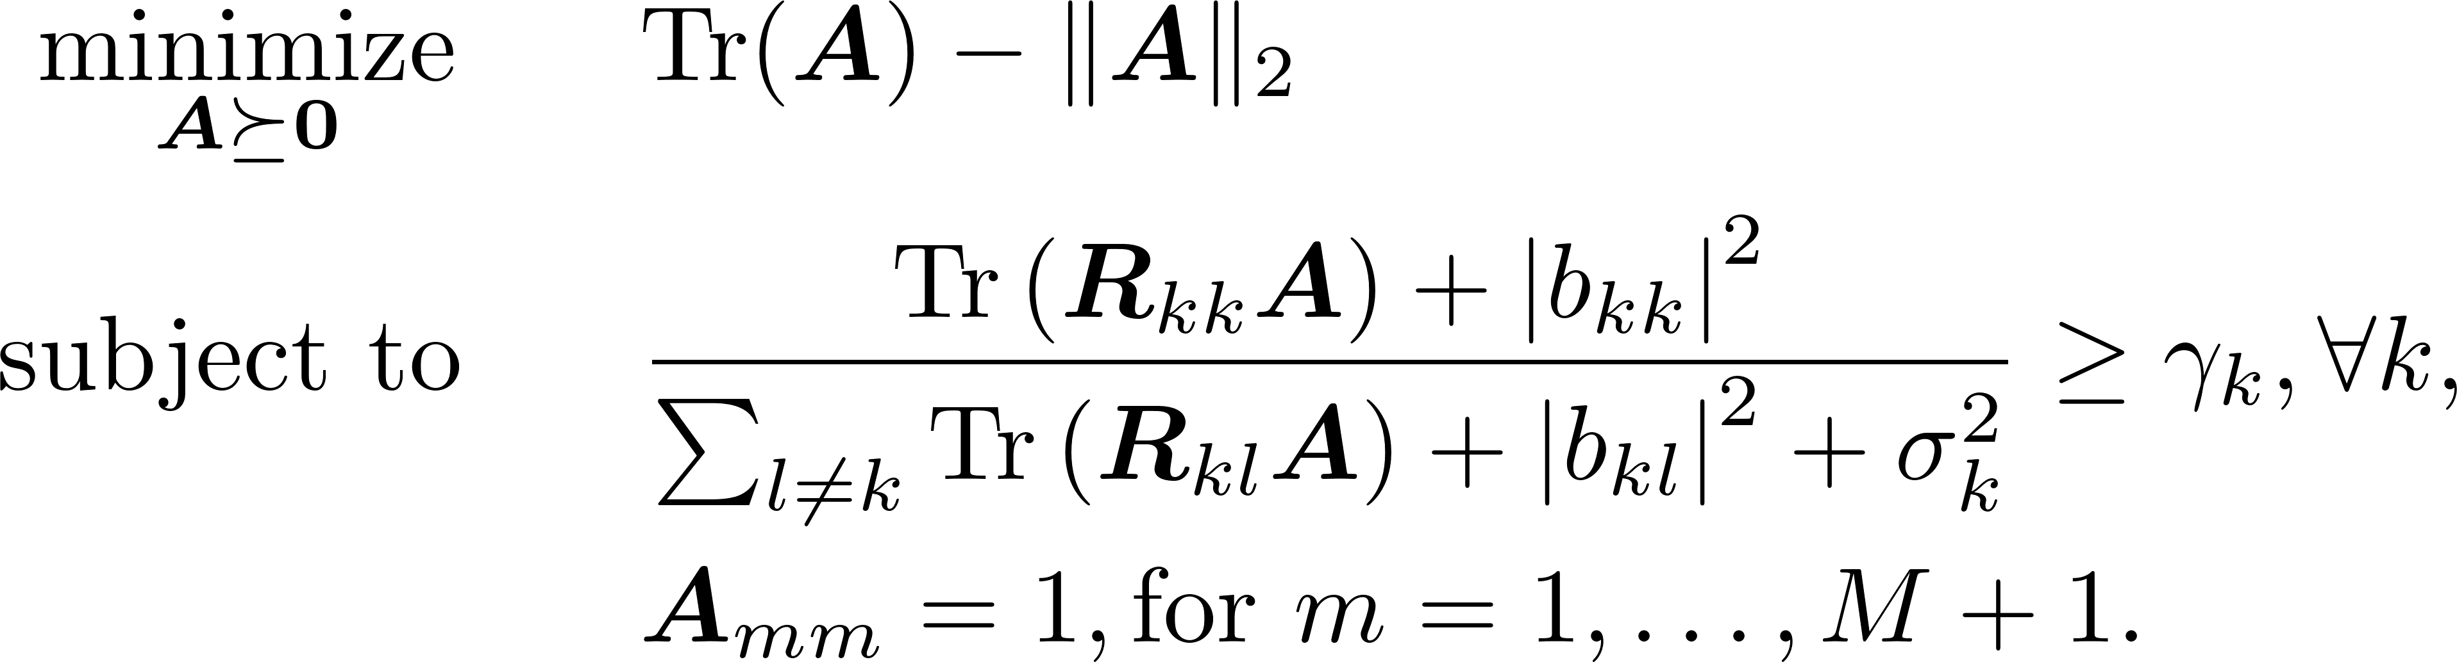
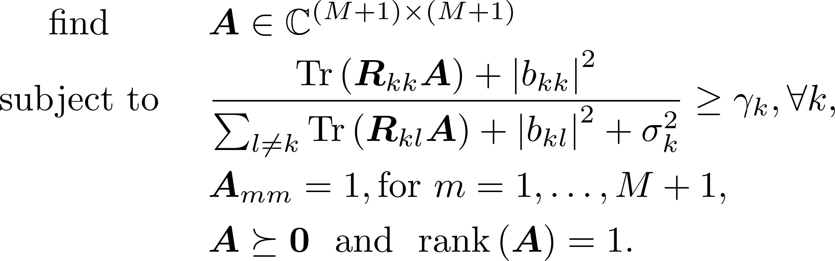
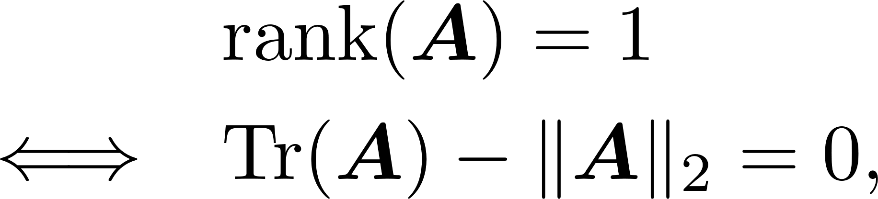
An alternating framework
Stage II: updating phase-shift matrix with fixed beamforming vectors
define
inhomogeneous QCQP
homogeneous QCQP
DC programming
matrix lifting
DC representation
Notes:
On the other hand, with fixed beamforming vectors, we need to optimize phase shifts Theta. Under the definition of a is a vector formed by all phases, the optimization problem is reduced to an inhomogeneous QCQP. Further by defining some notations and use the basic linear calculus, we transform it into a homogeneous QCQP. The challenge of nonconvex unit modulus constraints are addressed by the matrix lifting technique, and the problem turns out to be a semidefinite programming with nonconvex rank-one constraint. We propose a novel DC representation for the rank-one constraint and use DC programming to iteratively derive the solutions. The DC representation of rank-one constraint is to write it as the difference of trace norm and spectral norm, where the trace norm is defined as the sum of all singular values of a matrix and the spectral norm is defined as the largest singular value of a matrix. If the difference of these two norms are zero, we can conclude that only the largest singular value is non-zero, therefore the rank of this matrix is one.

Slide 25
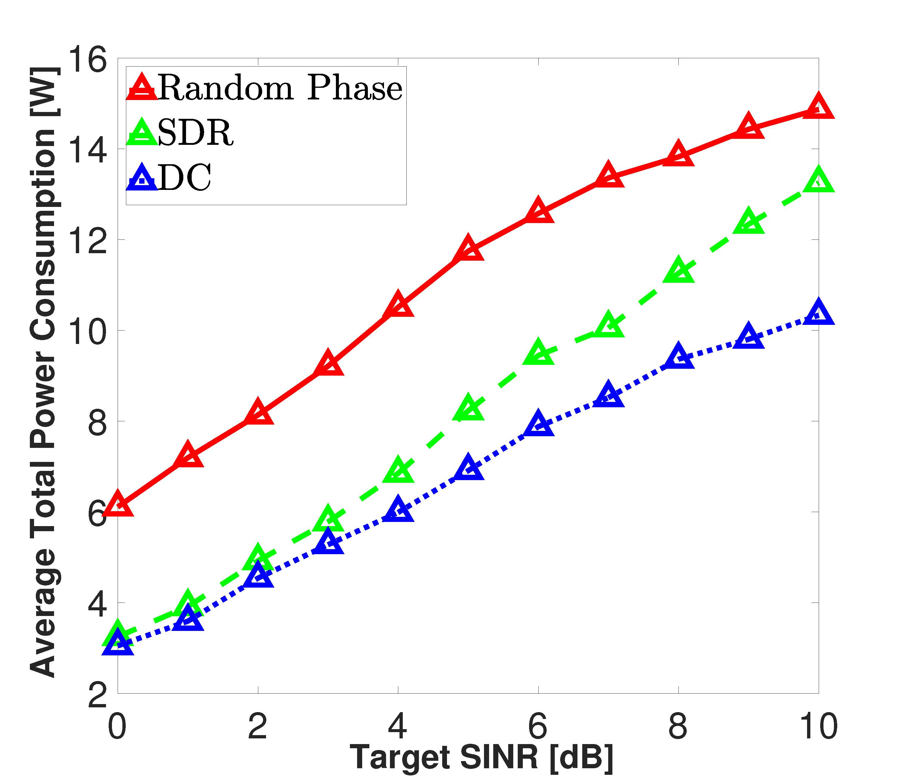
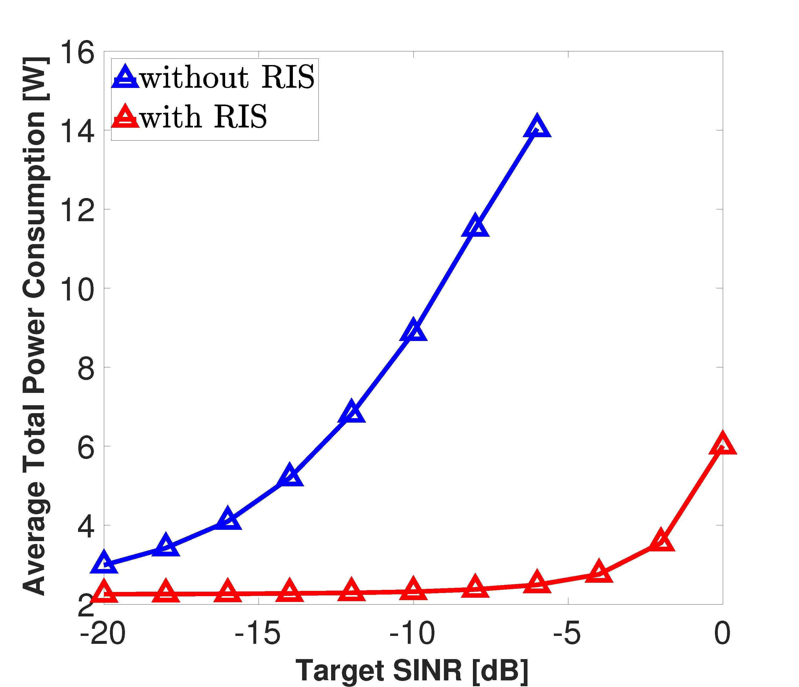
Simulation Results
Insights: deploying an RIS in edge inference system can significantly reduce the total power consumption
Notes:
In our first experiment, we compare the RIS-aided edge inference system to the RIS-free system. As we can see from the figure, deploying an RIS can significantly reduce the total power consumption and improve energy-efficiency. Moreover, it is worth mentioning that we can provide a much higher quality-of-service for the mobile users.

Slide 26
Simulation Results
Insights: the proposed DC significantly outperforms two benchmark algorithms in obtaining rank-one solutions
Notes:
In the second experiment, we show the superiority of our DC algorithm. SDR is a widely adopted algorithm to handle semidefinite programming with non-convex low-rank constraints by simply dropping these low-rank constraints. Random phase is chosen as another benchmark algorithm, where the phase shifts are randomly chosen from [0,2\pi]. We can see that DC significantly outperforms the other two algorithms, which demonstrates its superiority in finding rank-one solutions.

Slide 27
Concluding remarks
Edge inference over “intelligent” wireless networks
Edge inference empowered by reconfigurable intelligent surface
A mixed –norm and DC based alternating framework
Mixed -norm for group sparsity inducing
DC representation for low-rank functions
MM algorithm for DC programming
Notes:
In this talk, I show you an RIS-empowered energy-efficient edge inference system, where the RIS is deployed to make wireless networks more intelligent by smartly reflecting incident waves. As for the algorithm, we propose a mixed \ell_{1,2}-norm and DC based alternating framework, where the mixed \ell_{1,2}-norm is adopted for group sparsity inducing, and DC is adopted to effectively handle the rank-one constraints.

Slide 28
To learn more…
Web: http://shiyuanming.github.io/publicationstopic.html
Papers:
S. Hua and Y. Shi, “Reconfigurable intelligent surface for green edge inference in machine learning,” in Proc. IEEE Global Commun. Conf. (Globecom) Workshops, Waikoloa, Hawaii, USA, Dec. 2019.
S. Hua, Y. Zhou, K. Yang, and Y. Shi, “Reconfigurable intelligent surface for green edge inference,” submitted to IEEE Trans. Wireless Commun. 2019, https://arxiv.org/abs/1912.00820.
Notes:
If you are interested in our work, you can visit our web page for more reference. In this work we only consider the downlink transmission, and an extension of this work to consider both the uplink and downlink transmissions in an RIS-empowered edge inference system has been submitted to Transactions on Wireless Communications for possible publication. You may download it on arXiv.

Slide 29
Thanks
huasheng@shanghaitech.edu.cn
Notes:
Thank you all!

